Slide 1
SIGGRAPH 2025 Paper Sharing
25/08/27
Presenter: Yilin Wang

Slide 2
Paper List
Sketch2Anim: Towards Transferring Sketch Storyboards into 3D Animation
Multi-Person Interaction Generation from Two-Person Motion Priors

Slide 3
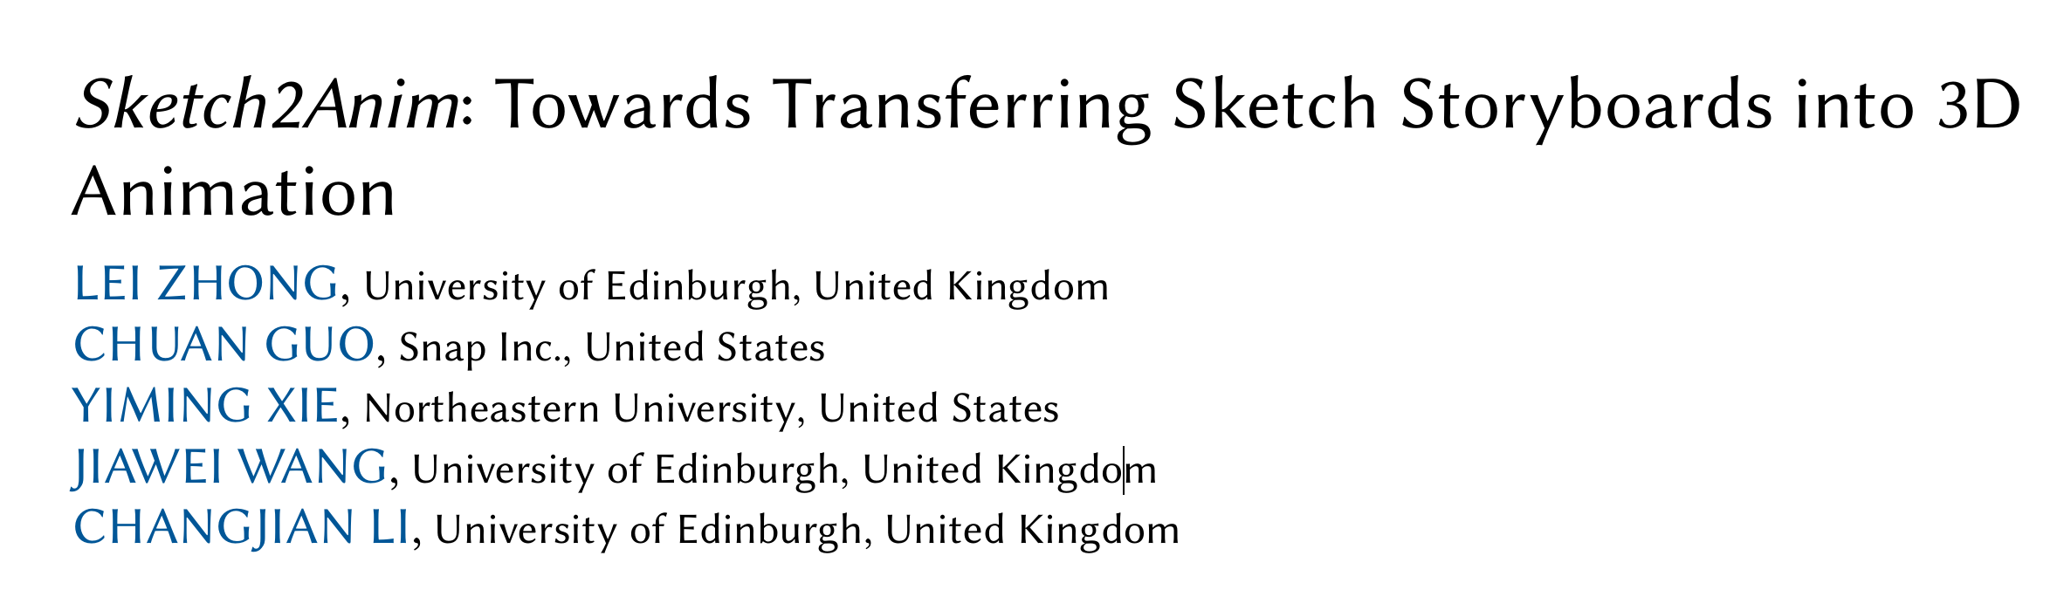
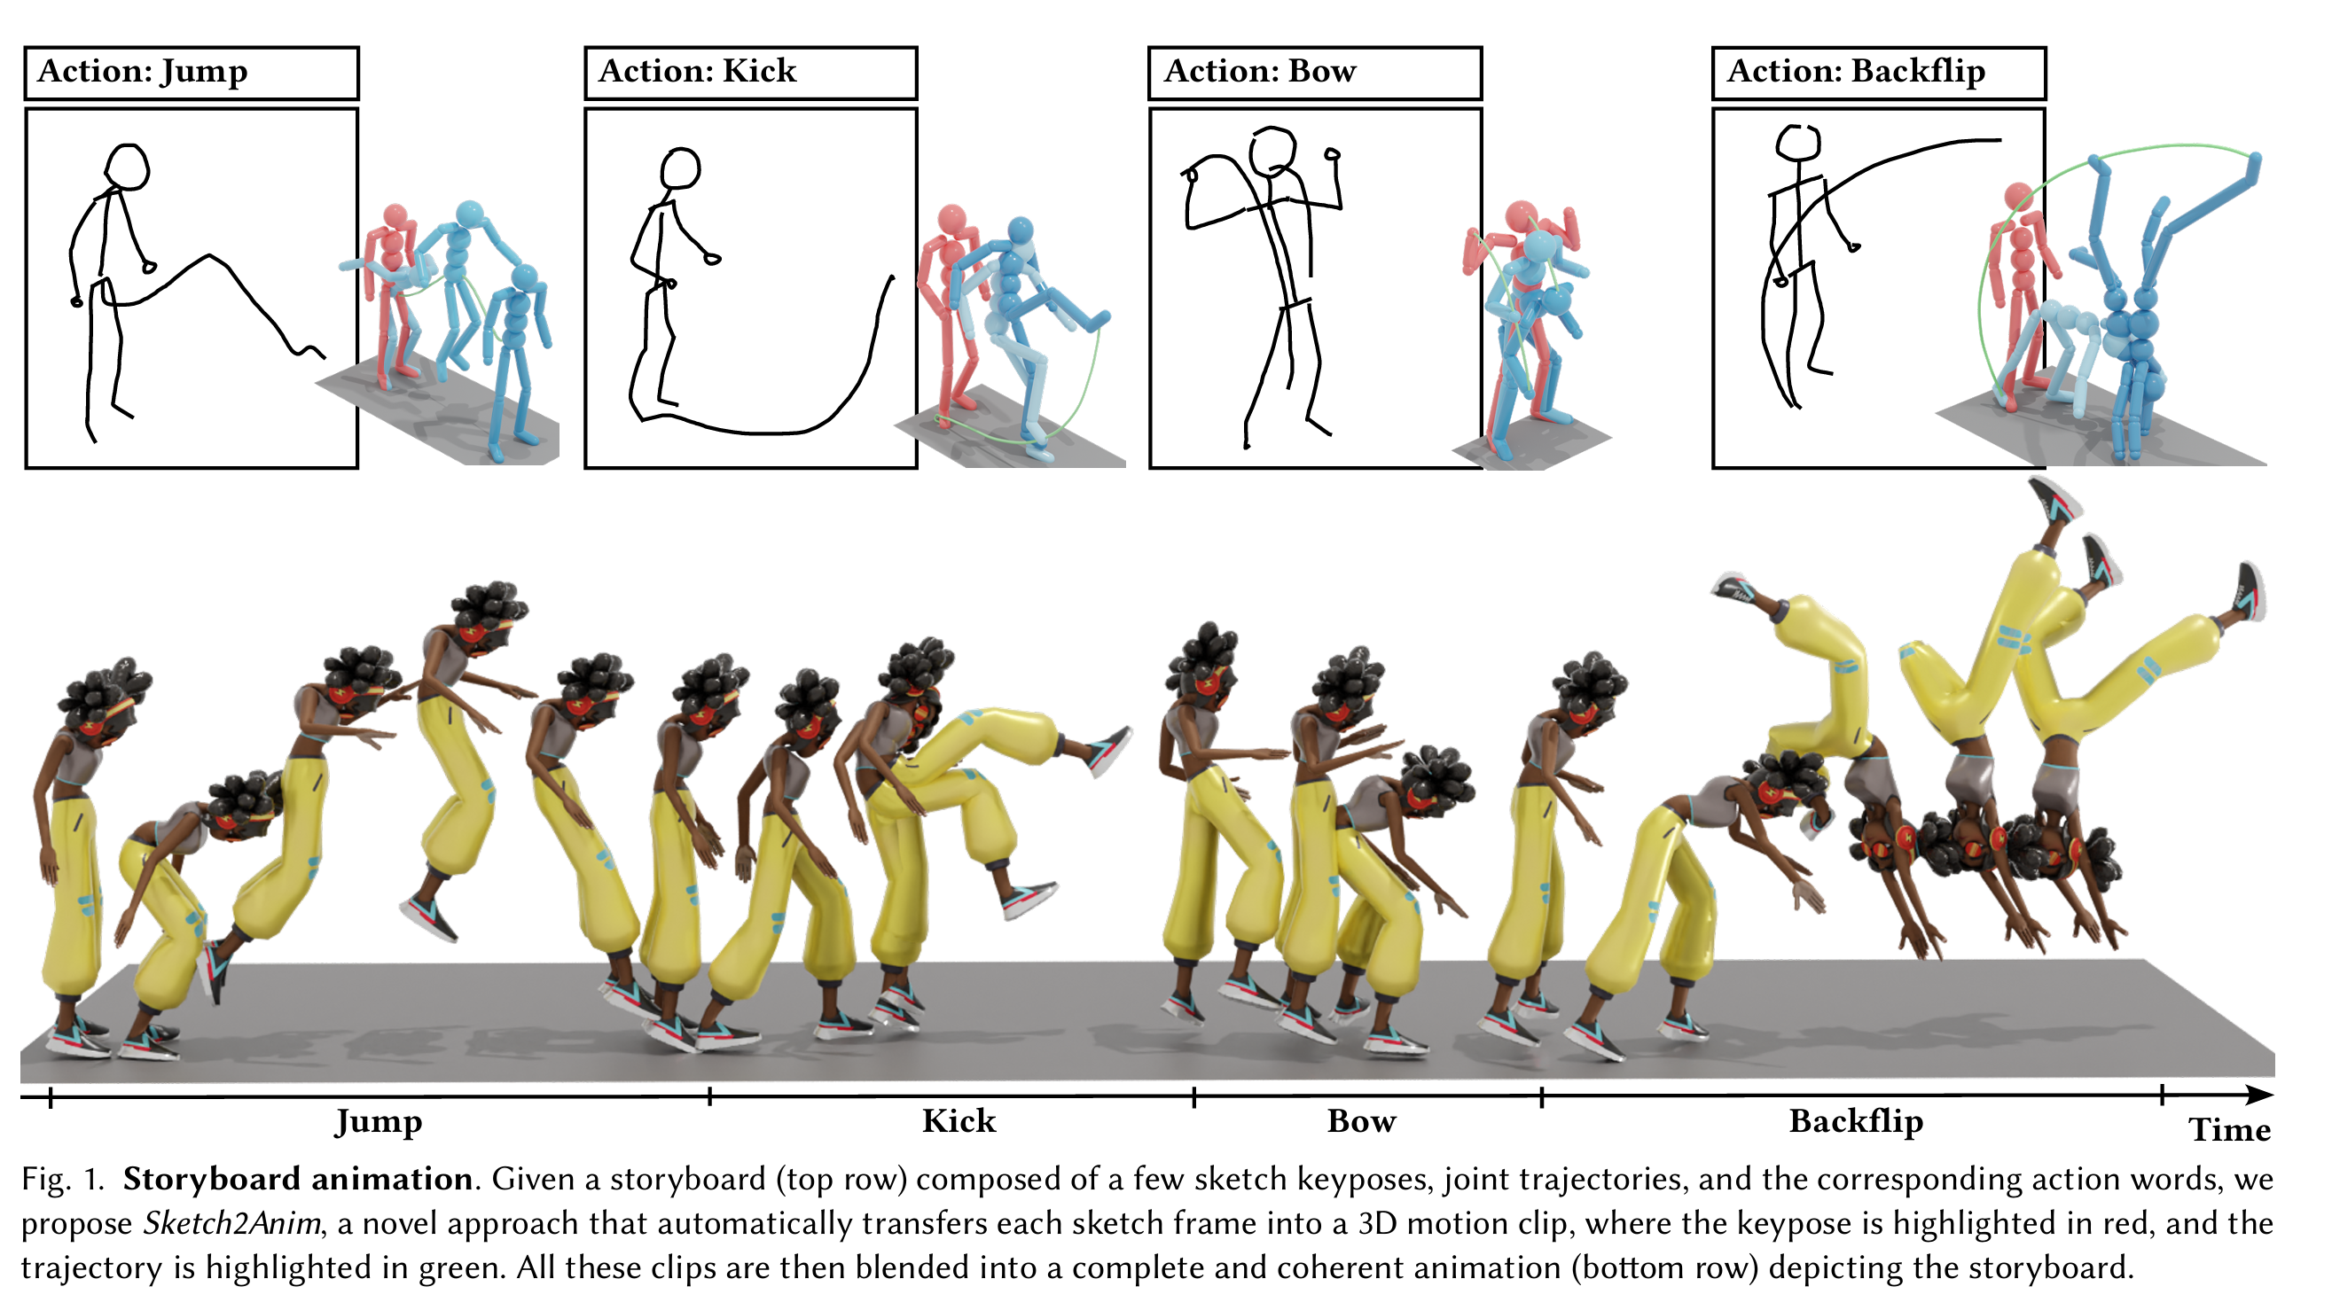
Sketch2Anim: Towards Transferring Sketch Storyboards into 3D Animation

Slide 4
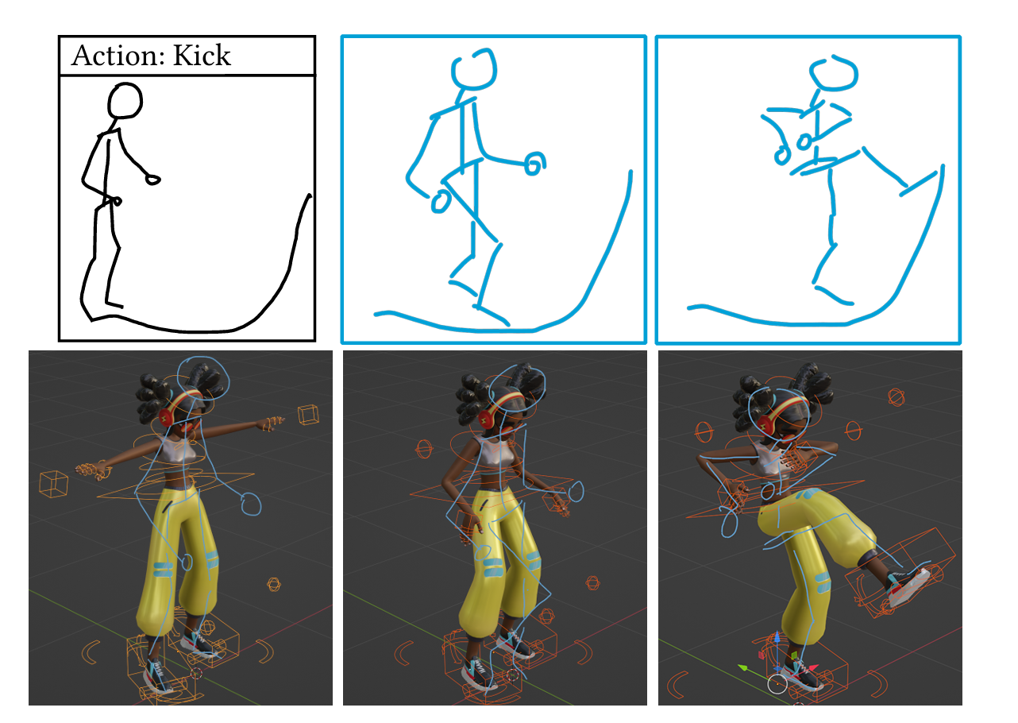
Motivation
Sketch storyboards paly an important role in artistic animation creation
Traditional workflow is both labor-intensive and time-consuming
Draw 2D keyposes along the 2D trajectory
2D keyposes imported into 3D software
Manually match 3D joints to the keyposes
Manually craft the desired 3D motion as the action word
A long trial-and-error process

Slide 5
Motivation
How to obtain the accurate 2D keypose and trajectory from the raw sketch of a storyboard?
How to produce a high-quality motion clip conditioned on the 2D keypose, trajectory, and action word?

Slide 6
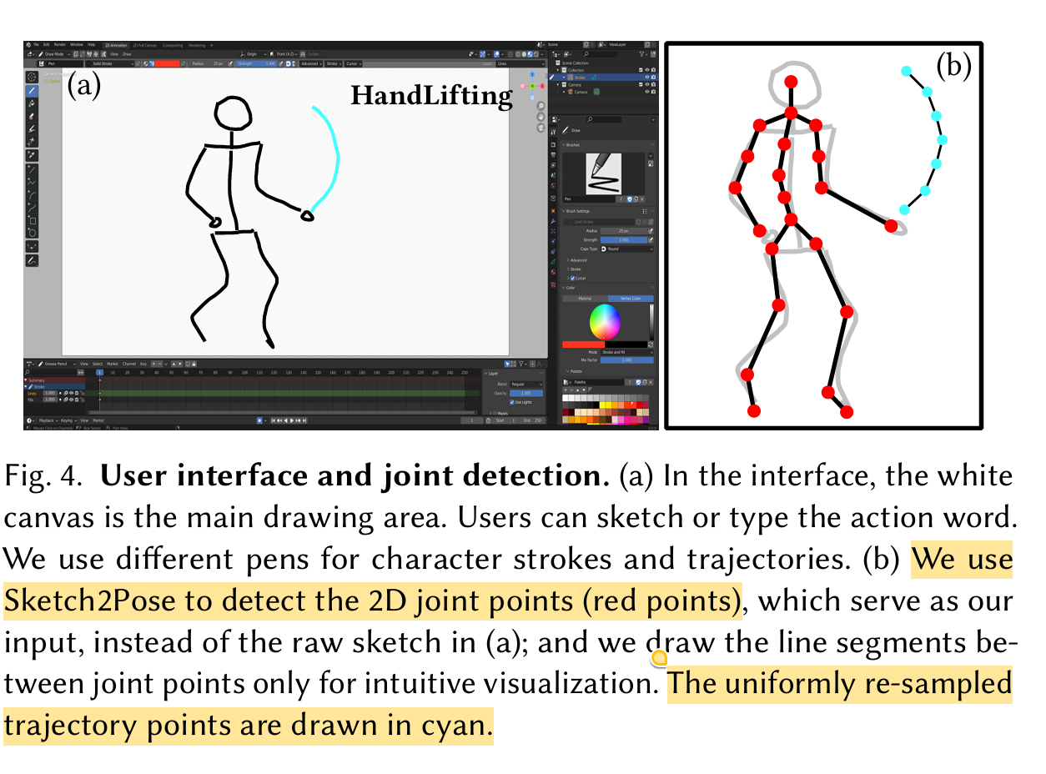
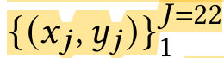
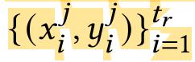
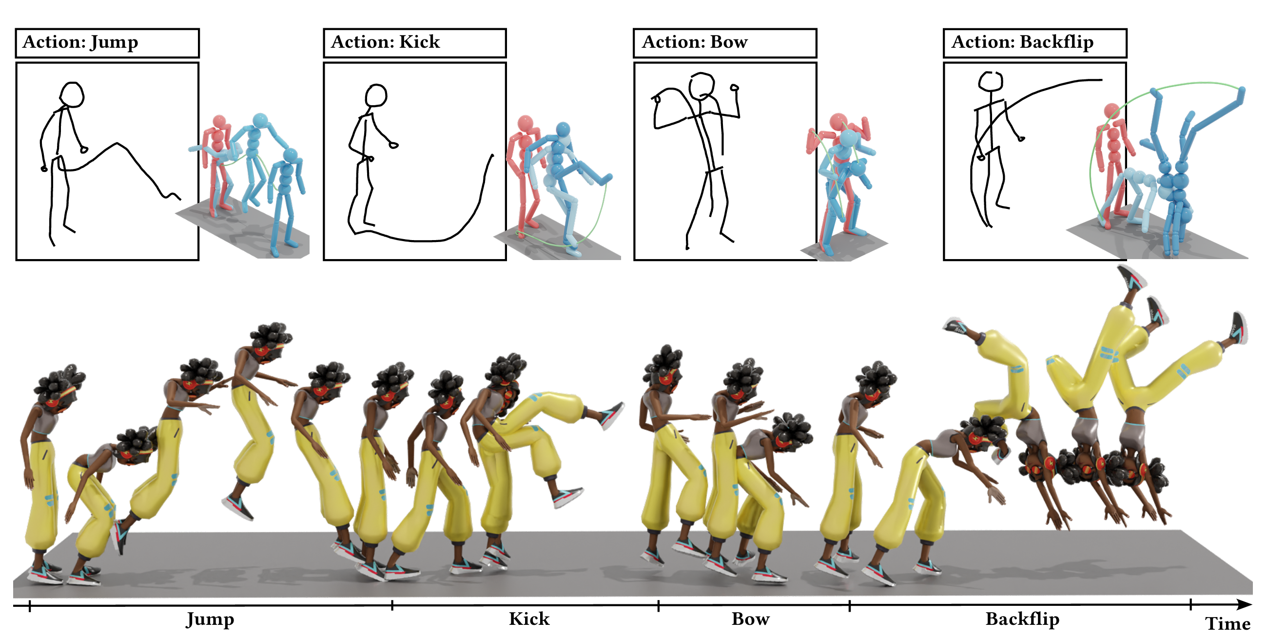
Methodology
Storyboard
Input
2D keypose (SMPL based)
2D trajectory points
Action word
Output
A single sketch frame → a 3D motion clip
3D motion clips ➔ final 3D motion

Slide 7
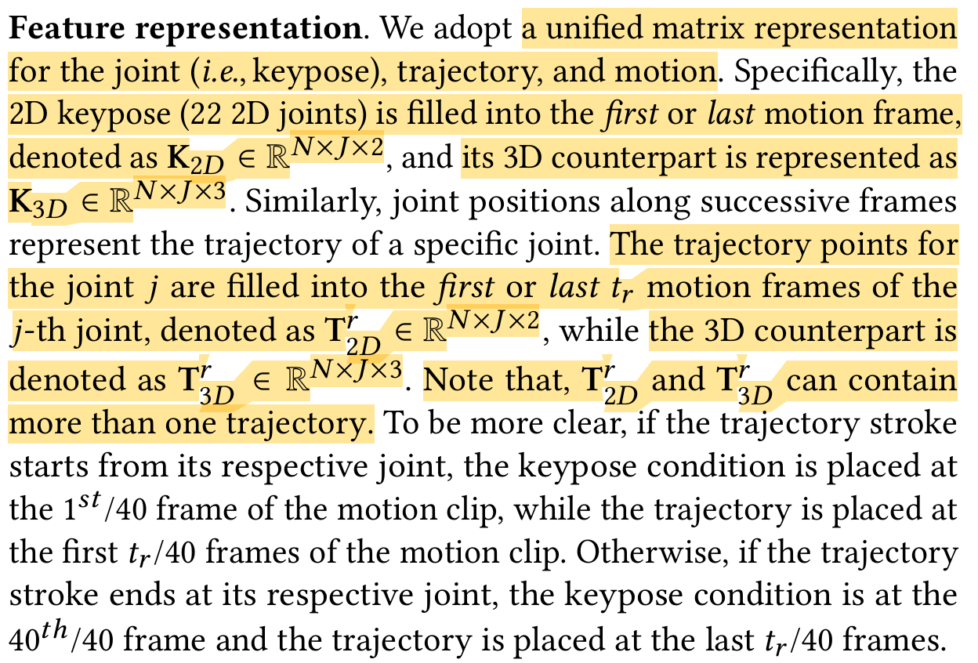
Methodology
Feature Representation

Slide 8
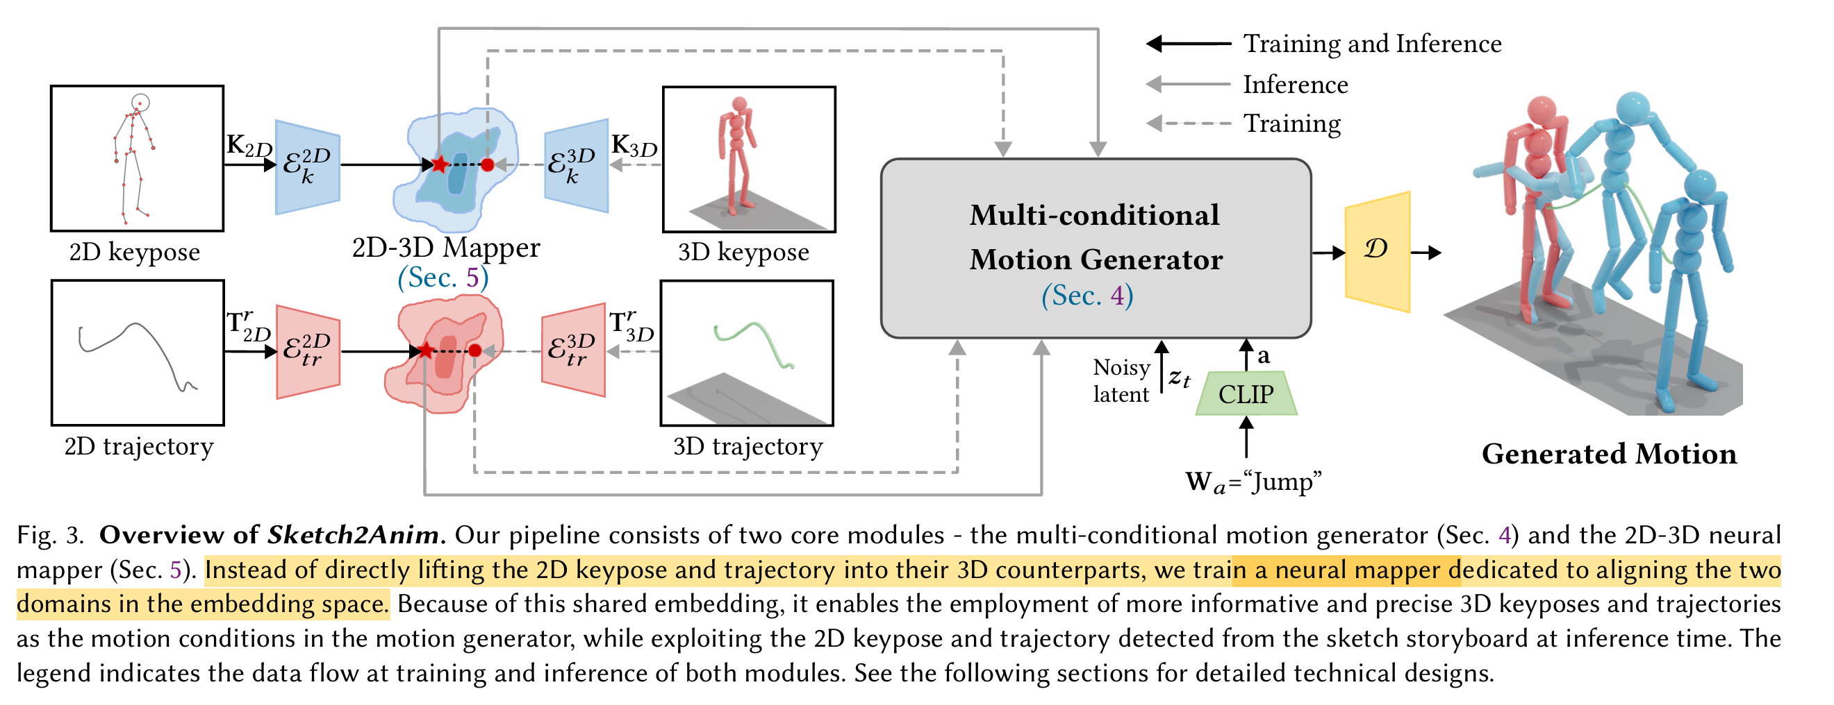
Methodology

Slide 9
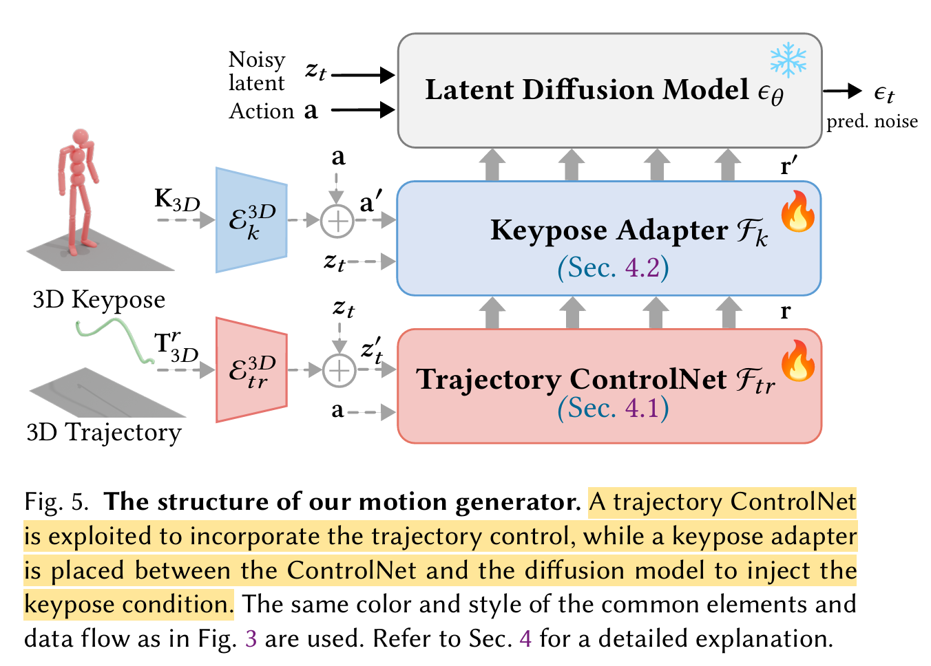
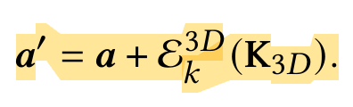
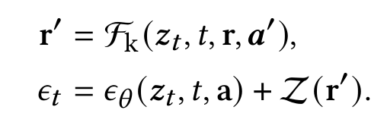
Methodology

Slide 10
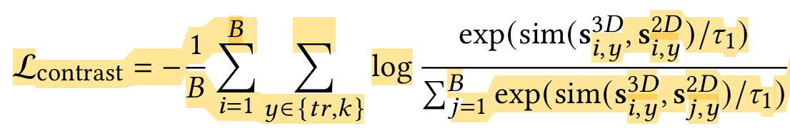
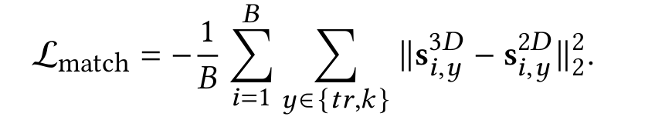
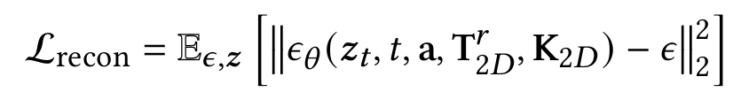
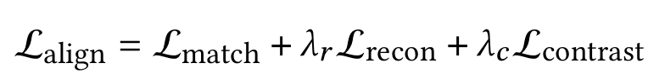
Methodology
2D-3D Trajectory and Keypose Alignment
Contrastive learning

Slide 11
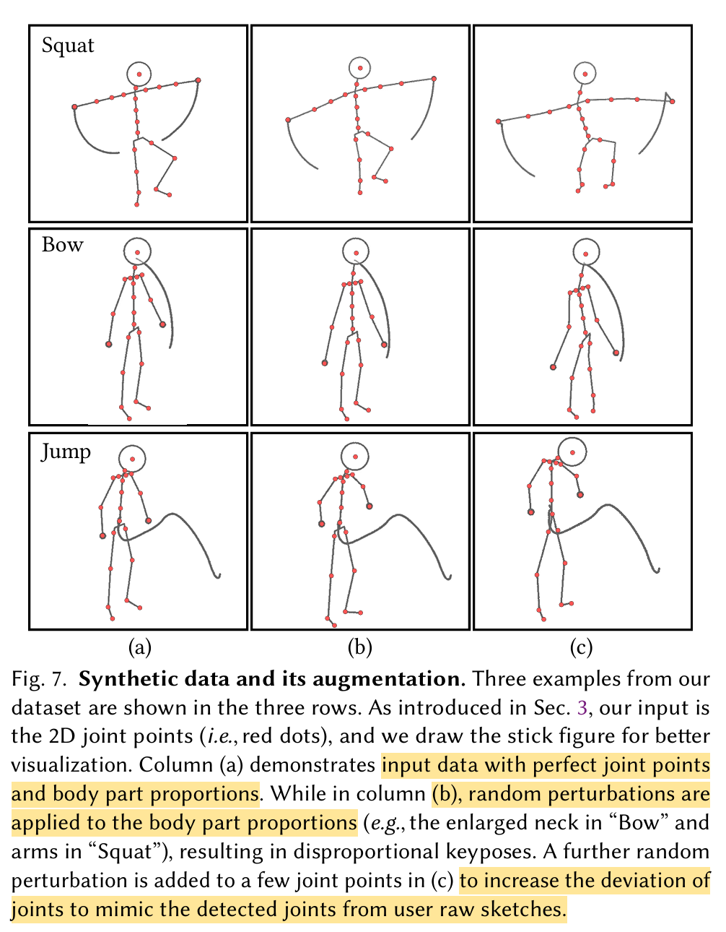
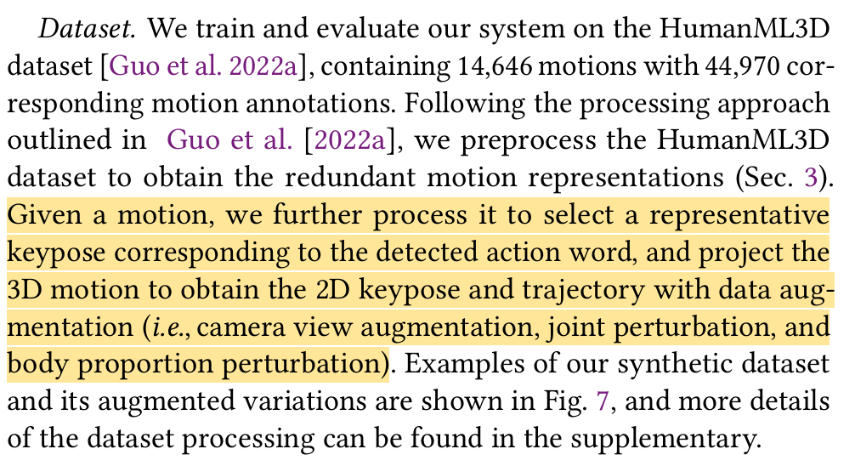
Dataset
Synthesized from HumanML3D dataset

Slide 12
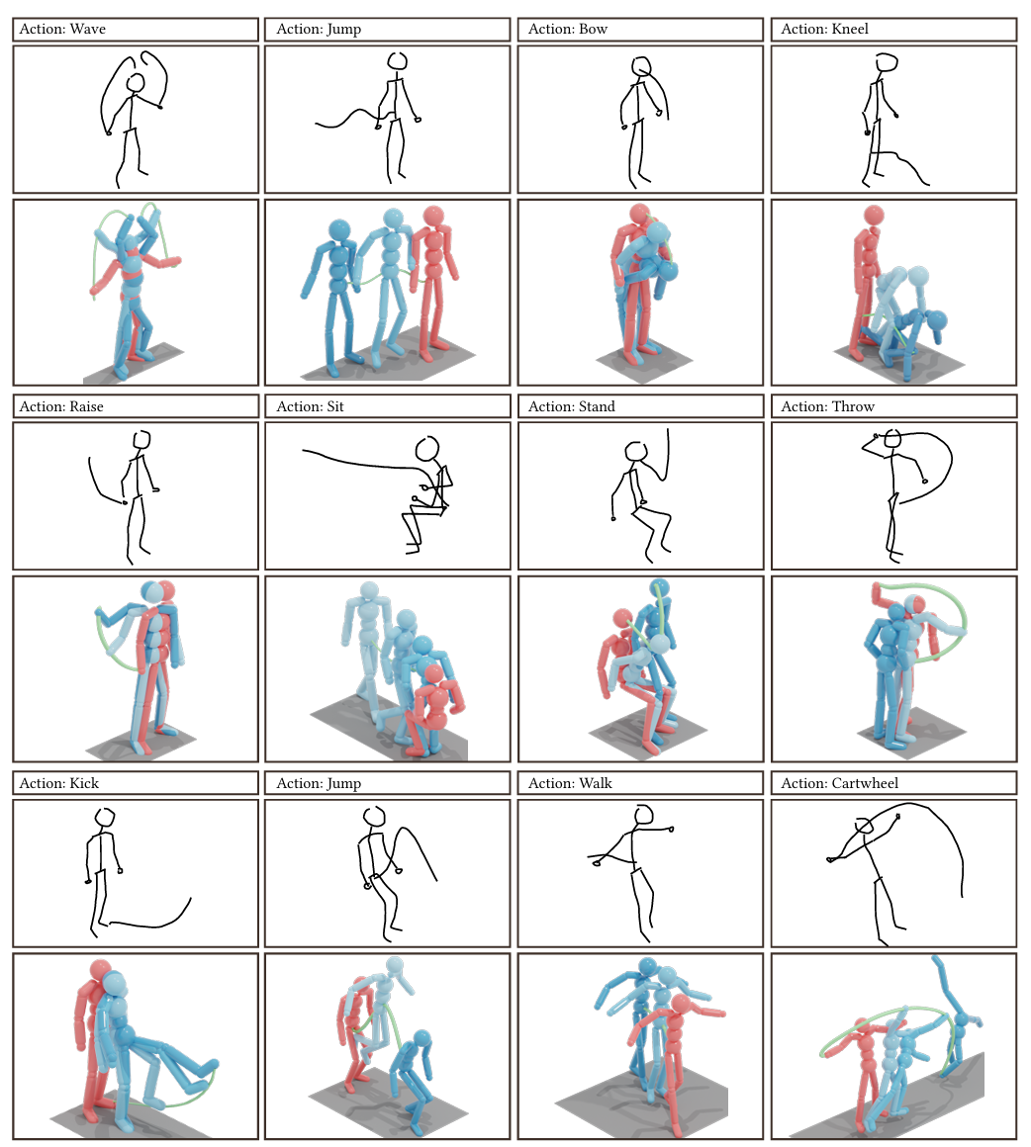
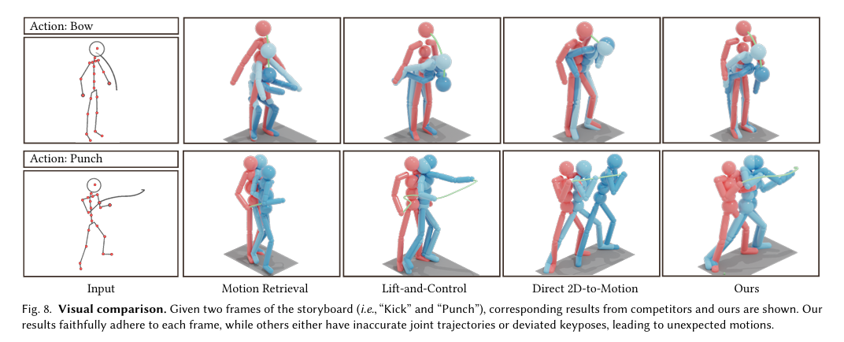
Results

Slide 13
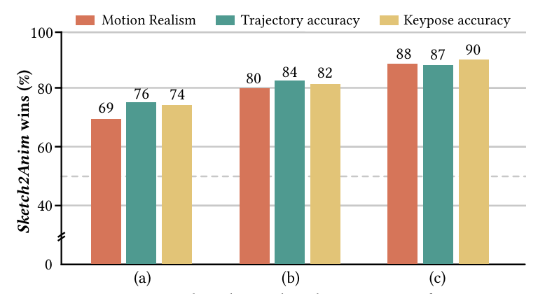
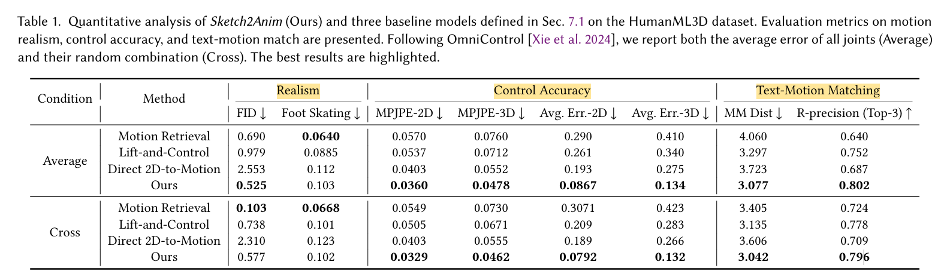
Results

Slide 14
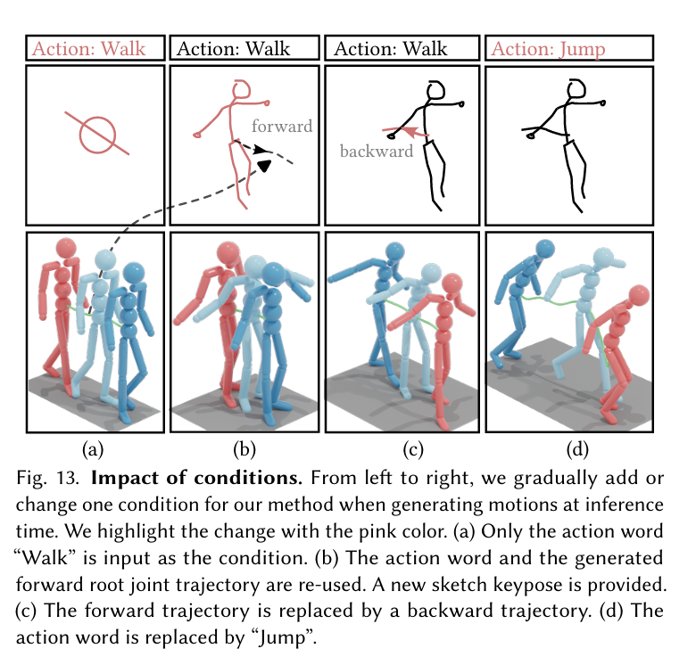
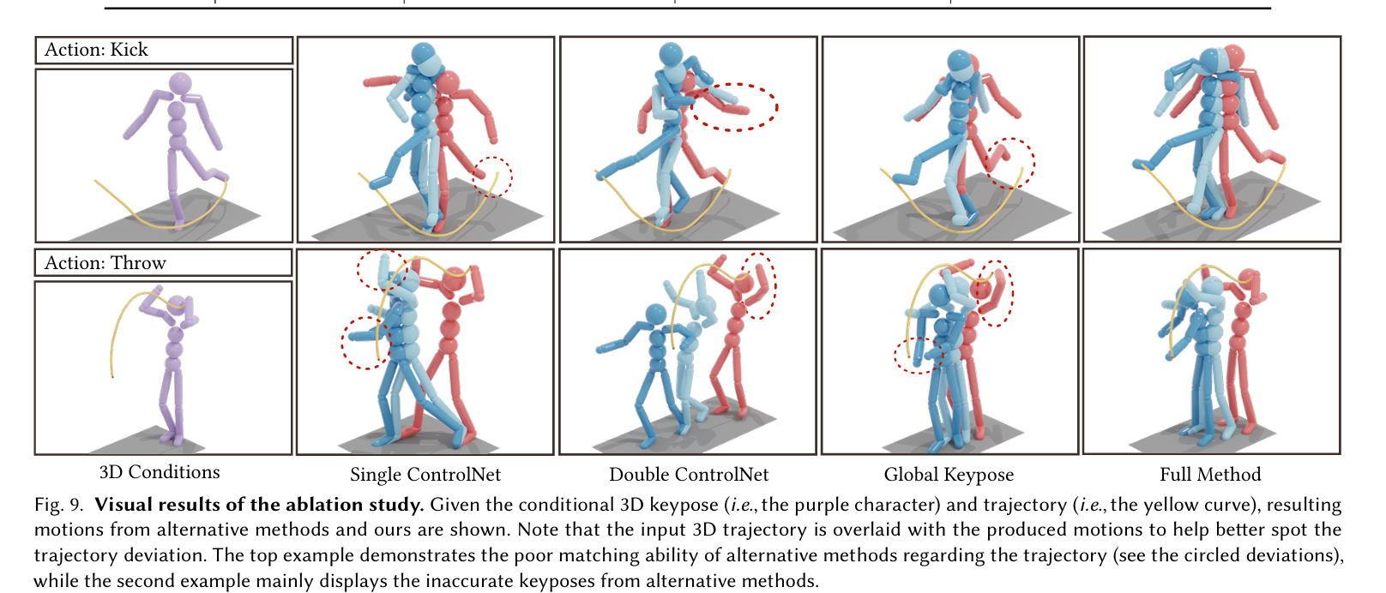
Ablation Study

Slide 15
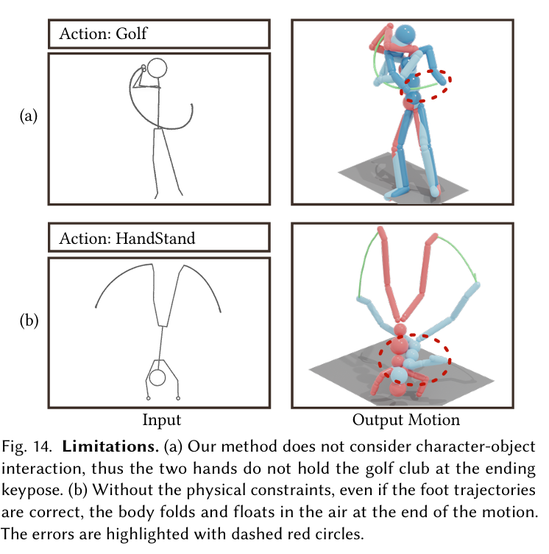
Limitations

Slide 16
Key Takeaway
2D sketches and symbols based control for 3D motion
A carefully trained neural mapper can effectively map 2D and 3D domains in the embedding space

Slide 17
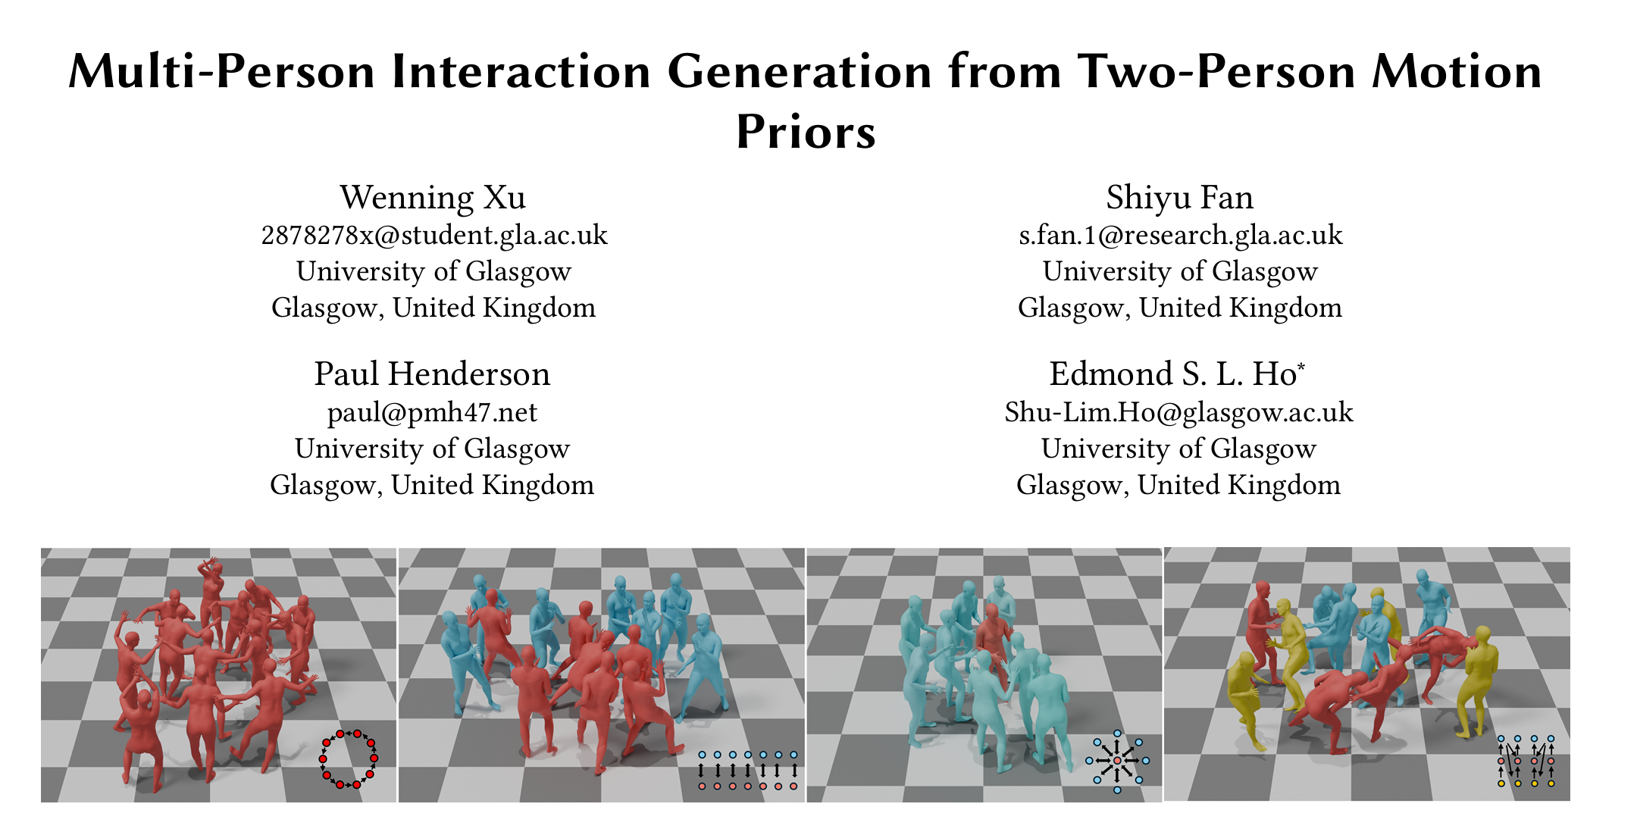
Multi-Person Interaction Generation from Two-Person Motion Priors

Slide 18
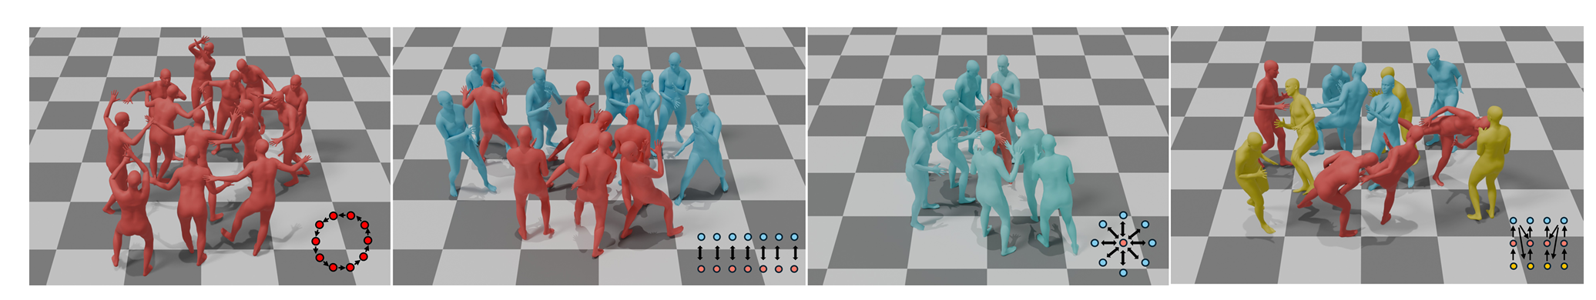
Motivation
multi-person interactions remain less explored due to the expensiveness of acquiring high-quality MOCAP data
➔ Spatially and temporally separate complex multi-person interactions into a graph structure of two-person interactions

Slide 19
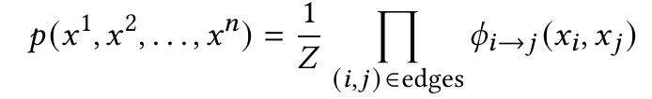
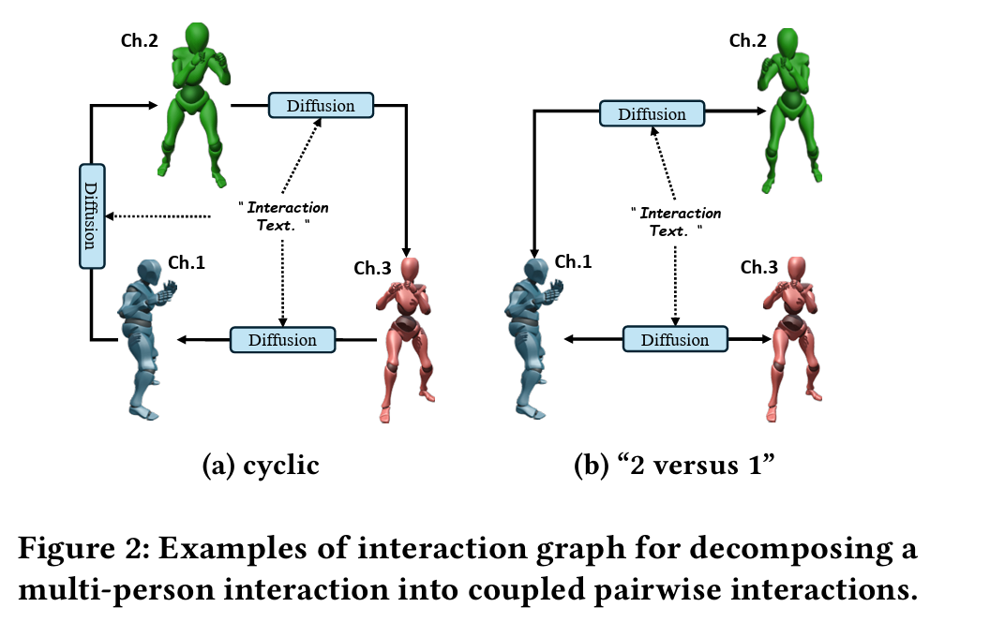
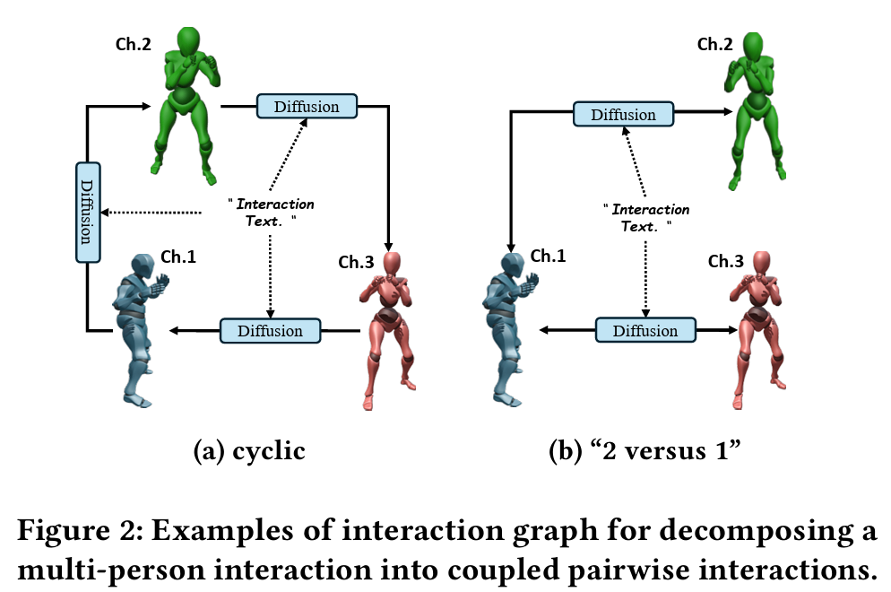
Methodology
Multi-person Sampling based on Pairwise Interaction Graph

Slide 20
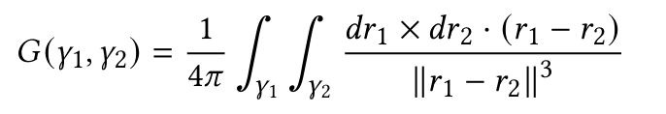
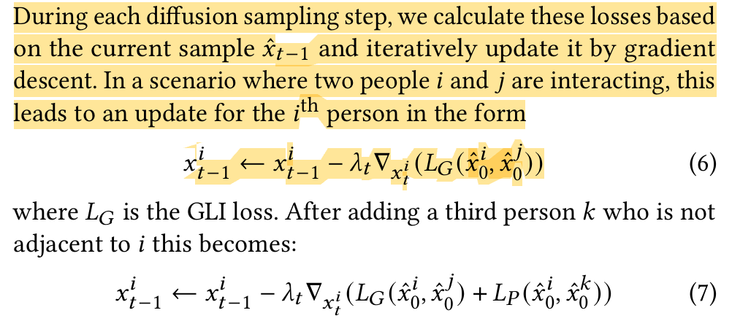
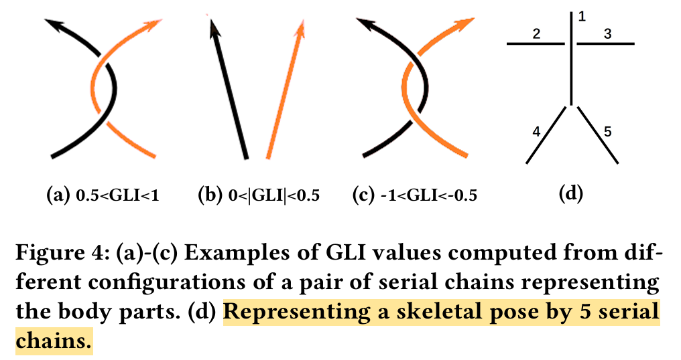
Methodology
Interaction Sampling Optimization
Proxemics Loss
Gauss Linking Intergral(GLI) Loss
Diffusion Posterior Sampling Optimization

Slide 21
Evaluation
Dataset
→ A small close interaction subset from InterHuman testset (~ 20,000 frames)
Metrics
Text-to-motion performance
R-Precision, FID, Diversity, multi-modal distance
Motion Quality
Skating ratio, jitter
Interaction Quality
PeneBone ➔ the collision depth between characters’ skeletons by modeling each bone using a box with a radius of 2cm
Contact & Cframe ➔ contact points per frame & contact frame rate represent the collision magnitude between characters when the generated motions are fitted to the SMPL model
Pair-FID ➔ the FID of all interaction pairs in the multi-person interactions

Slide 22
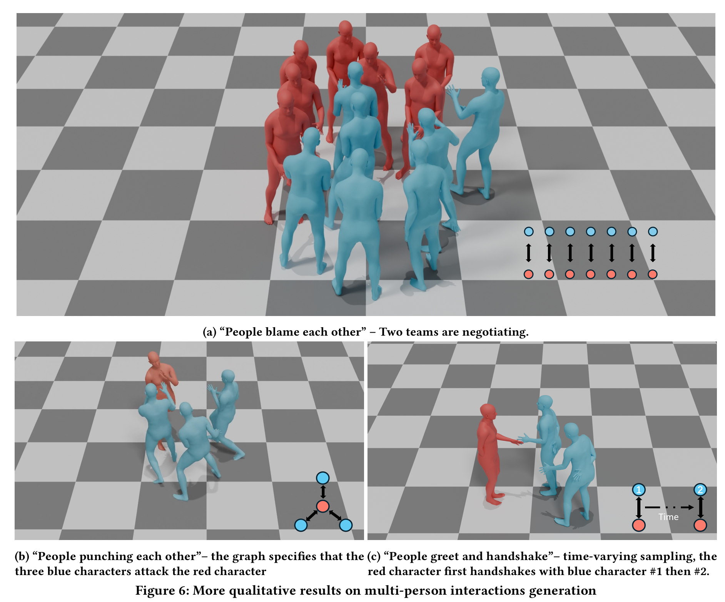
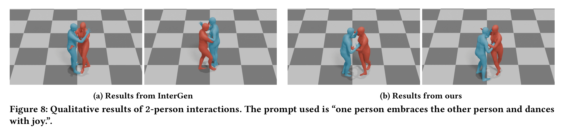
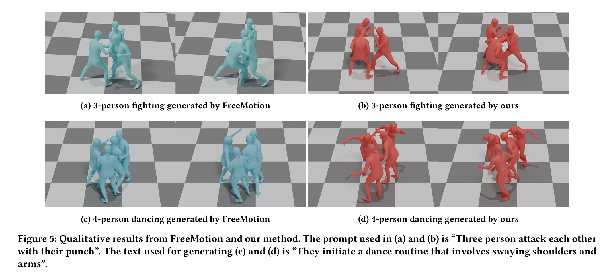
Results

Slide 23
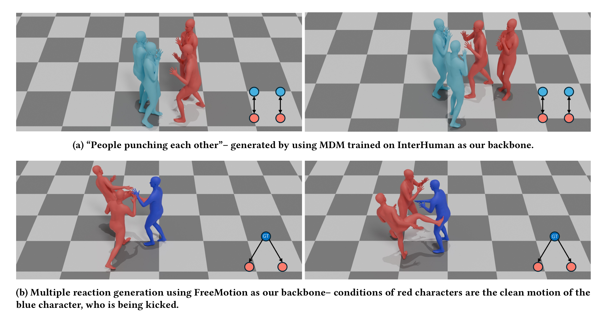
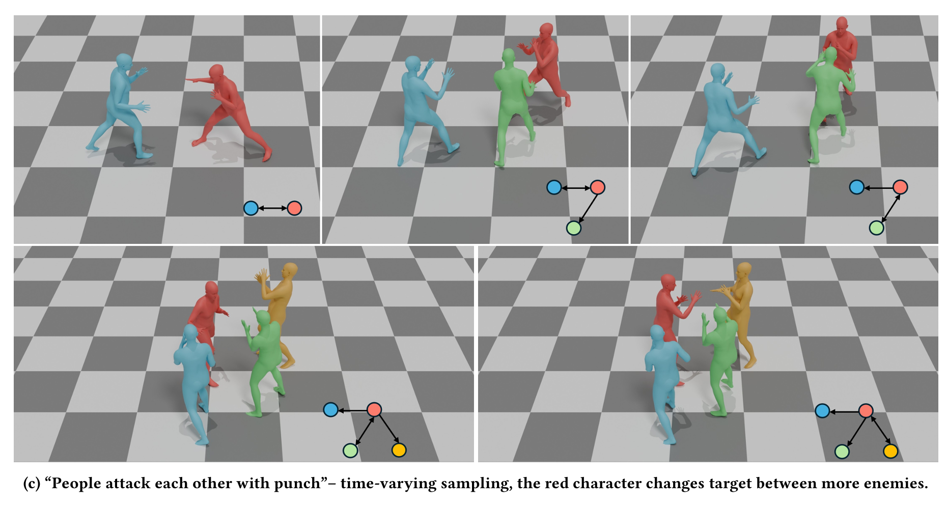
Results

Slide 24
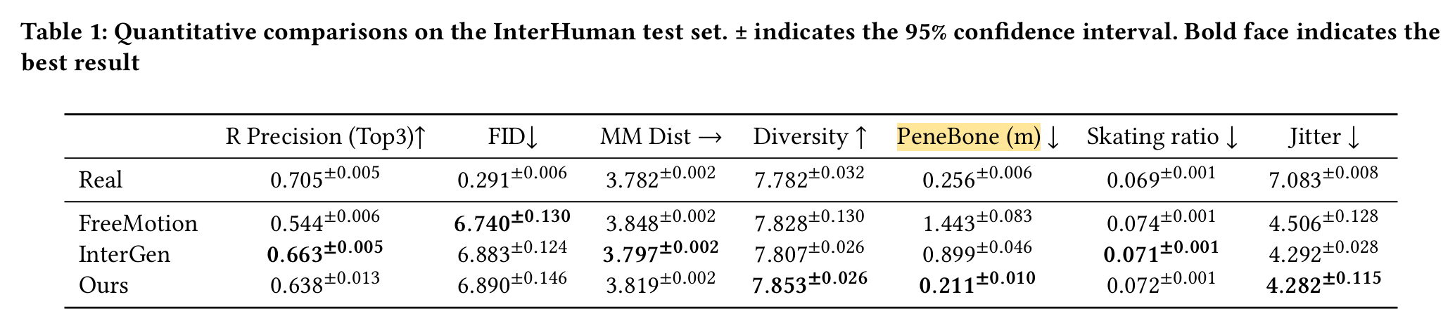
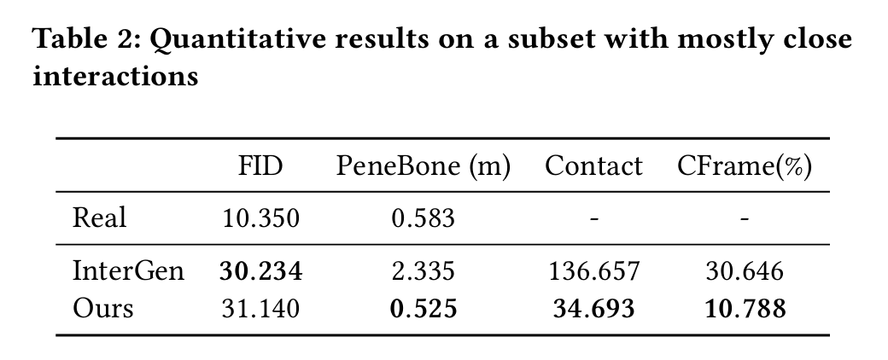
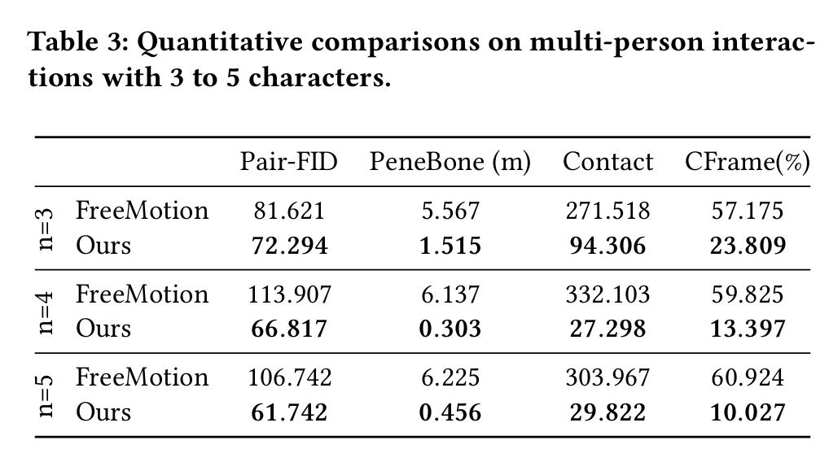
Results

Slide 25
Limitations
Cannot capture relationship between nodes that are not directly connected

Slide 26
Key Takeaway
Optimization methods based on graph modelling of interaction between multiple characters
Possibility of generalizing similar graph modelling methods to train-from-scratch a powerful multi-person motion generative model?

